Slide 1
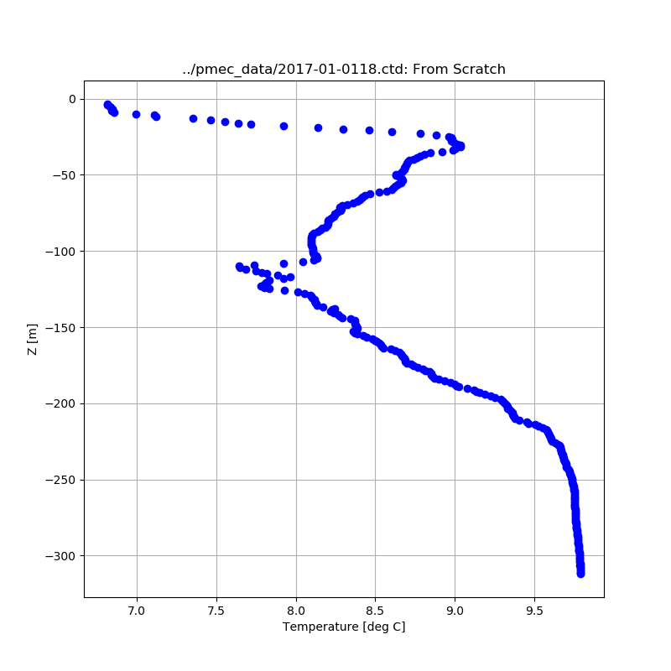
Data plotting exercise

Slide 2
Goal: Make a plot of Temperature versus Depth from the CTD Data
Write a program in [mydir] that reads in [mydir]_data/2017-01-0118.ctd and saves lists of depth and temperature
HINT: the data starts around line 571 (counting from 1)
HINT: the header describing the columns is just above that line
HINT: use line.split() to make a list out of the items on a data line = *, and then you can get at individual items in * by indexing
HINT: you can initialize an empty list for storing depth or temperature using "my_list = []" and then append items to it using "my_list.append(item)"
HINT: convert things to floats using "float([some string from *])" when appending them to your data lists
Plot as x = temperature, y = -depth
Save the plot to [mydir]_output/out_test_1.png
HINT: use the shared/my_module.make_dir() method to make sure the output directory exists

Slide 3
Extra credit
Do the same thing using the pandas "read_csv" method.

Slide 4
My version - for reference
is in the Files in my repo: pmec/ex_intro/plot_ctd_data.py

